Slide 1
Managing people
Managing people working as individuals and in groups

Slide 2
People in the process
People are an organisation’s most important assets.
The tasks of a manager are essentially people-oriented. Unless there is some understanding of people, management will be unsuccessful.
Poor people management is an important contributor to project failure.

Slide 3
People management factors
Consistency
  Team members should all be treated in a comparable way without favourites or discrimination.
Respect
  Different team members have different skills and these differences should be respected.
Inclusion
  Involve all team members and make sure that people’s views are considered.
Honesty
  You should always be honest about what is going well and what is going badly in a project.

Slide 4
Selecting staff
An important project management task is team selection.
Information on selection comes from:
  Information provided by the candidates.
  Information gained by interviewing and talking with candidates.
  Recommendations and comments from other people who know or who have worked with the candidates.

Slide 5
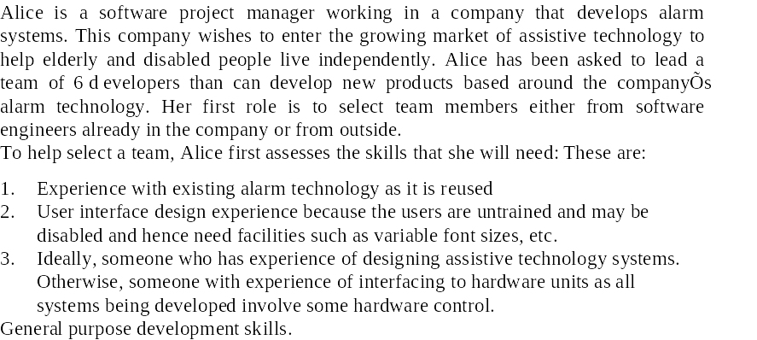
Staff selection case study 1

Slide 6
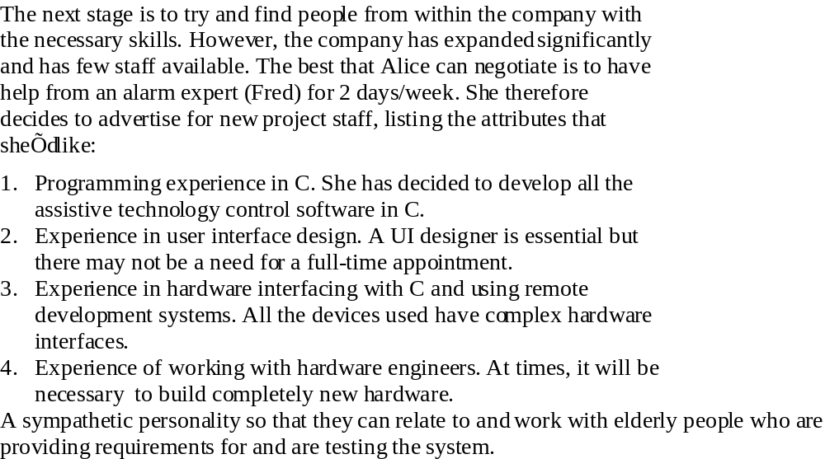
Staff selection case study 2

Slide 7
Lessons
Managers in a company may not wish to lose people to a new project. Part-time involvement may be inevitable.
Skills such as UI design and hardware interfacing are in short supply.
Recent graduates may not have specific skills but may be a way of introducing new skills.
Technical proficiency may be less important than social skills.

Slide 8
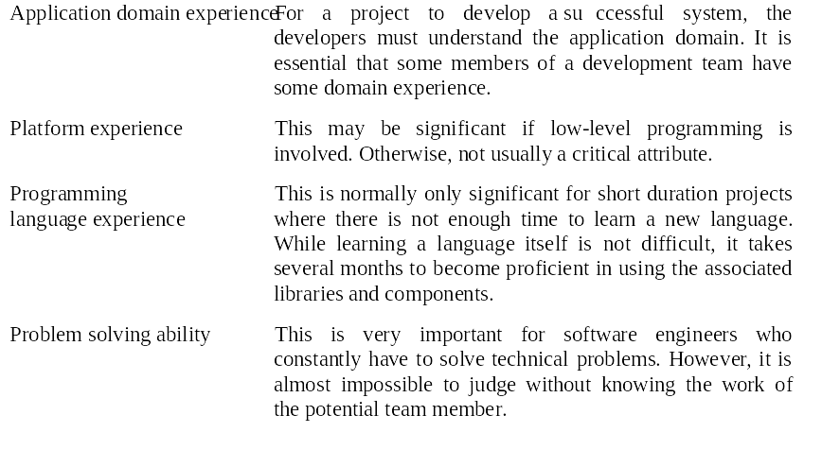
Staff selection factors 1

Slide 9
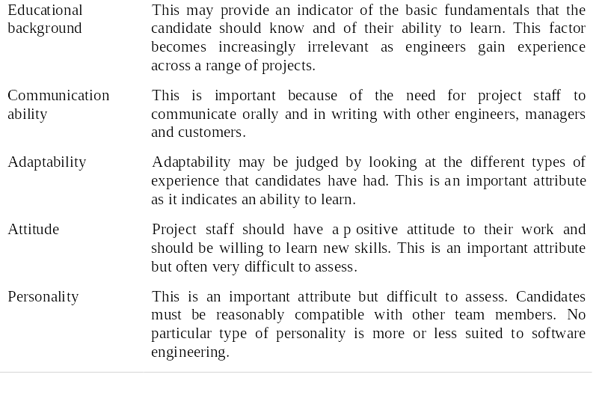
Staff selection factors 2

Slide 10
Motivating people
An important role of a manager is to motivate the people working on a project.
Motivation is a complex issue but it appears that their are different types of motivation based on:
  Basic needs (e.g. food, sleep, etc.);
  Personal needs (e.g. respect, self-esteem);
  Social needs (e.g. to be accepted as part of a group).

Slide 11
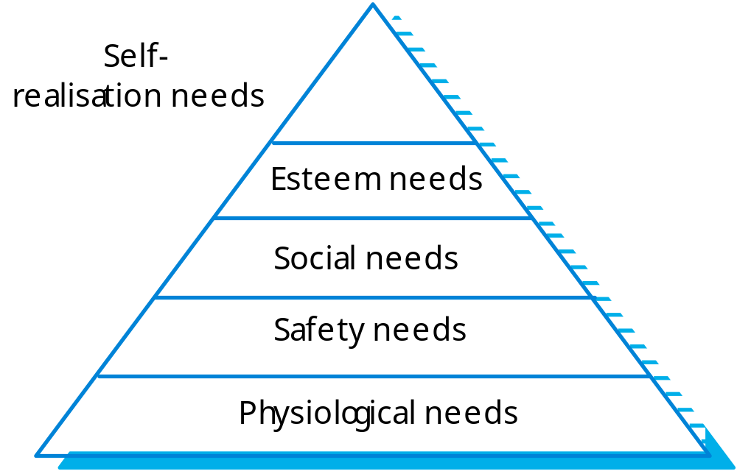
Human needs hierarchy

Slide 12
Need satisfaction
Social
  Provide communal facilities;
  Allow informal communications.
Esteem
  Recognition of achievements;
  Appropriate rewards.
Self-realization
  Training - people want to learn more;
  Responsibility.

Slide 13
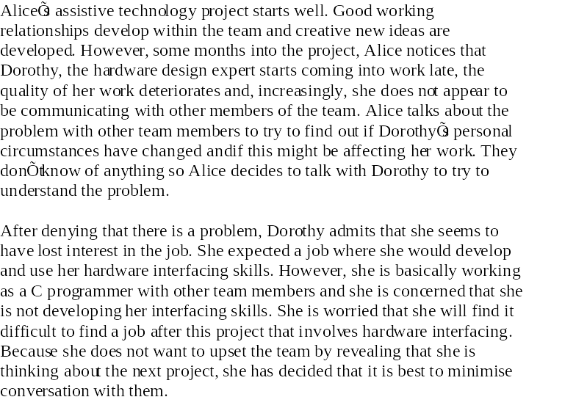
Individual motivation

Slide 14
Personality types
The needs hierarchy is almost certainly an over-simplification of motivation in practice.
Motivation should also take into account different personality types:
  Task-oriented;
  Self-oriented;
  Interaction-oriented.

Slide 15
Personality types
Task-oriented.
  The motivation for doing the work is the work itself;
Self-oriented.
  The work is a means to an end which is the achievement of individual goals - e.g. to get rich, to play tennis, to travel etc.;
Interaction-oriented
  The principal motivation is the presence and actions of
  co-workers. People go to work because they like to go to
  work.

Slide 16
Motivation balance
Individual motivations are made up of elements
of each class.
The balance can change depending on personal
circumstances and external events.
However, people are not just motivated by personal factors but also by being part of a group and culture.
People go to work because they are motivated by the people that they work with.

Slide 17
Managing groups
Most software engineering is a group activity
  The development schedule for most non-trivial software projects is such that they cannot be completed by one person working alone.
Group interaction is a key determinant of group performance.
Flexibility in group composition is limited
  Managers must do the best they can with available people.

Slide 18
Factors influencing group working
Group composition.
Group cohesiveness.
Group communications.
Group organisation.

Slide 19
Group composition
Group composed of members who share the
same motivation can be problematic
  Task-oriented - everyone wants to do their own thing;
  Self-oriented - everyone wants to be the boss;
  Interaction-oriented - too much chatting, not enough work.
An effective group has a balance of all types.
This can be difficult to achieve software engineers are often task-oriented.
Interaction-oriented people are very important as they can detect and defuse tensions that arise.

Slide 20
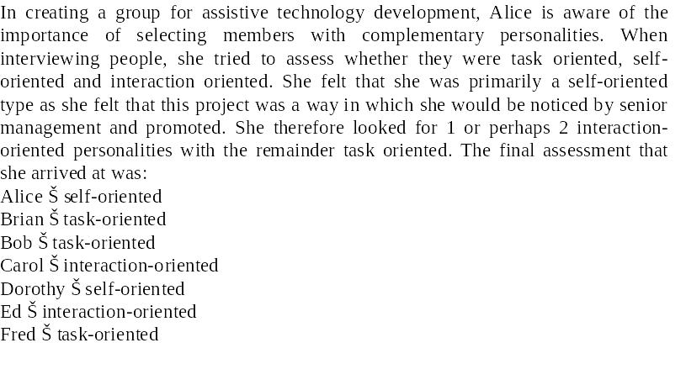
Group composition

Slide 21
Group leadership
Leadership depends on respect not titular
status.
There may be both a technical and an
administrative leader.
Democratic leadership is more effective that
autocratic leadership.

Slide 22
Group cohesiveness
In a cohesive group, members consider the group to be more important than any individual in it.
The advantages of a cohesive group are:
  Group quality standards can be developed;
  Group members work closely together so inhibitions caused by ignorance are reduced;
  Team members learn from each other and get to know each other’s work;
  Egoless programming where members strive to improve each other’s programs can be practised.

Slide 23
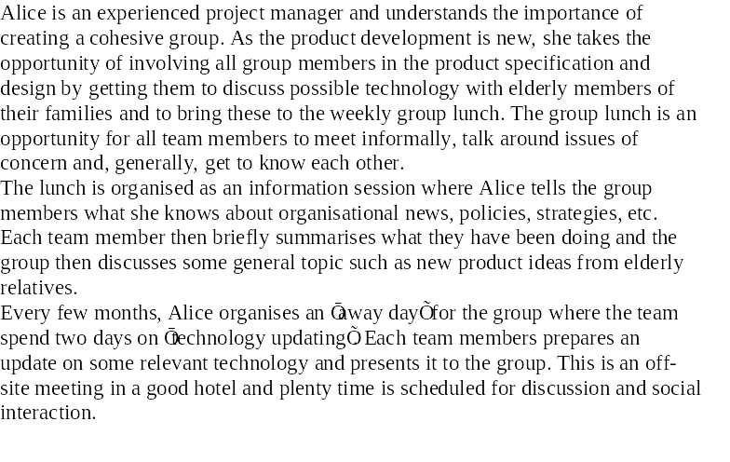
Team spirit

Slide 24
Developing cohesiveness
Cohesiveness is influenced by factors such as the organisational culture and the personalities in the group.
Cohesiveness can be encouraged through
  Social events;
  Developing a group identity and territory;
  Explicit team-building activities.
Openness with information is a simple way of ensuring all group members feel part of the group.

Slide 25
Group loyalties
Group members tend to be loyal to cohesive groups.
'Groupthink' is preservation of group
irrespective of technical or organizational
considerations.
Management should act positively to avoid
groupthink by forcing external involvement with each group.

Slide 26
Group communications
Good communications are essential for effective group working.
Information must be exchanged on the status of work, design decisions and changes to previous decisions.
Good communications also strengthens group cohesion as it promotes understanding.

Slide 27
Group communications
Group size
  The larger the group, the harder it is for people to communicate with other group members.
Group structure
  Communication is better in informally structured groups than in hierarchically structured groups.
Group composition
  Communication is better when there are different personality types in a group and when groups are mixed rather than single sex.
The physical work environment
  Good workplace organisation can help encourage communications.

Slide 28
Group organisation
Small software engineering groups are usually organised informally without a rigid structure.
For large projects, there may be a hierarchical structure where different groups are responsible for different sub-projects.

Slide 29
Informal groups
The group acts as a whole and comes to a consensus on decisions affecting the system.
The group leader serves as the external interface of the group but does not allocate specific work items.
Rather, work is discussed by the group as a whole and tasks are allocated according to ability and experience.
This approach is successful for groups where all members are experienced and competent.

Slide 30
Extreme programming groups
Extreme programming groups are variants of an informal, democratic organisation.
In extreme programming groups, some ‘management’ decisions are devolved to group members.
Programmers work in pairs and take a collective responsibility for code that is developed.

Slide 31
Chief programmer teams
Consist of a kernel of specialists helped by others added to the project as required.
The motivation behind their development is the wide difference in ability in different programmers.
Chief programmer teams provide a supporting environment for very able programmers to be responsible for most of the system development.

Slide 32
Problems
This chief programmer approach, in different forms, has been successful in some settings.
However, it suffers from a number of problems
  Talented designers and programmers are hard to find. Without exceptional people in these roles, the approach will fail;
  Other group members may resent the chief programmer taking the credit for success so may deliberately undermine his/her role;
  There is a high project risk as the project will fail if both the chief and deputy programmer are unavailable.
  The organisational structures and grades in a company may be unable to accommodate this type of group.

Slide 33
Working environments
The physical workplace provision has an important
effect on individual productivity and satisfaction
  Comfort;
  Privacy;
  Facilities.
Health and safety considerations must be taken
into account
  Lighting;
  Heating;
  Furniture.

Slide 34
Environmental factors
Privacy - each engineer requires an area for
uninterrupted work.
Outside awareness - people prefer to work in
natural light.
Personalization - individuals adopt different
working practices and like to organize their
environment in different ways.

Slide 35
Workspace organisation
Workspaces should provide private spaces where people can work without interruption
  Providing individual offices for staff has been shown to increase productivity.
However, teams working together also require spaces where formal and informal meetings can be held.

Slide 36
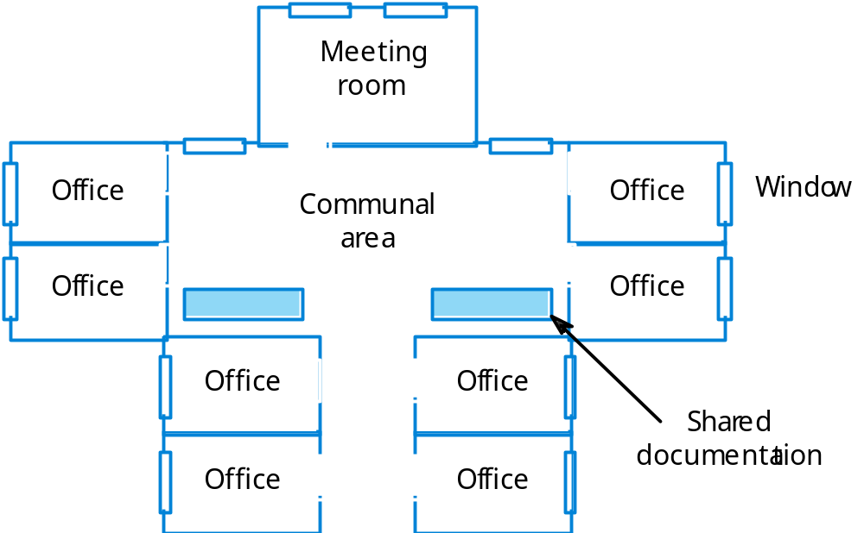
Office layout

Slide 37
The People Capability Maturity Model
Intended as a framework for managing the development of people involved in software development.

Slide 38
P-CMM Objectives
To improve organisational capability by improving workforce capability.
To ensure that software development capability is not reliant on a small number of individuals.
To align the motivation of individuals with that of the organisation.
To help retain people with critical knowledge and skills.

Slide 39
P-CMM levels
Five stage model
  Initial. Ad-hoc people management
  Repeatable. Policies developed for capability improvement
  Defined. Standardised people management across the organisation
  Managed. Quantitative goals for people management in place
  Optimizing. Continuous focus on improving individual competence and workforce motivation

Slide 40
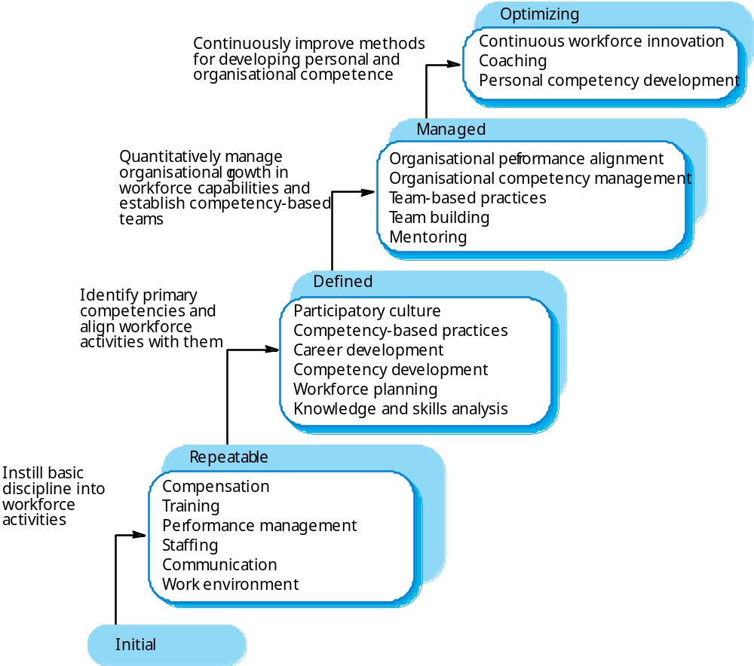
The people capability model

